Slide 1
Social Media

Slide 2
References
McLuhan, Theories of Media
Jenkins et al. Confronting the challenges of participatory culture: Media education for the 21st century, 2006. (see GitHub resources)
Tom Standage, Writing in the Wall
What is Web 2.0 by O'Reilly
Carol Jones video on Web 2.0: http://blip.tv/file/508079
Web 2^{W}, by Raman http://portal.acm.org/citation.cfm?id=1461928.1461945

Slide 3
Learning Objectives
Learn (think) about the principles underlying Social Media. Be able to articulate some of the benefits and limitations of its use.
How does it fit with other CSCW tools? (often used for organization…)
Social media, fad or here to stay?
Notes:
Already watched this video.

Slide 4
Outline
Theories of media
Social media technologies
Characteristics of social media
Social media channels and their affordances
Opportunities and challenges

Slide 5
Outline
Theories of media
Social media technologies
Characteristics of social media
Social media channels and their affordances
Opportunities and challenges

Slide 6
Role of Media in
Communities of Practice
Communities of practice -- “groups of people who share a concern or a passion for something they do and learn how to do it better as they interact regularly” [Wenger]
Ongoing learning for core and peripheral members – “living curriculum for the apprentice” where long term members share practices, resources and tools
Media play an essential role in supporting communication, collaboration and coordination activities within a community of practice.
Notes:
People outside the community recognize that the community exists and value the skills and relationships members have.
Social scientists study communities of practice to discern how people learn from one another and to understand successful relationships and practices
Such insights can be helpful in building new communities or sharing practices across communities.

Slide 7
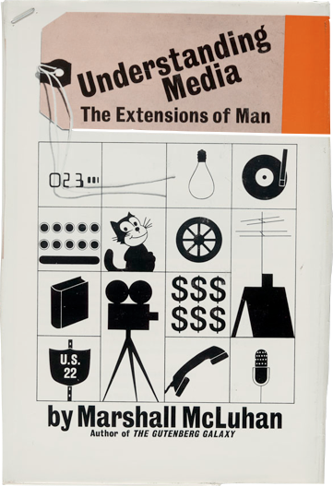
Notes:
TRIBAL ERA -> PRINT ERA -> DIGITAL ERA -> INFORMATION ERA
So most people are now in agreement that social media has taken the world by storm.... for researchers, it is now up to us to make sense of that impact!
But where to start in that regard?
Marshall McLuhan, a Canadian that died in the 1980’s, had uncanny premonitions of what was ahead as far as back as the 1960’s... he wrote some interesting books on understanding the laws of media, and he described that humans have moved from a tribal era to a print era to a digital era (e.g. TV) to an information era. I suspect if he were alive today, he might say we are now living in a social era.

Slide 8
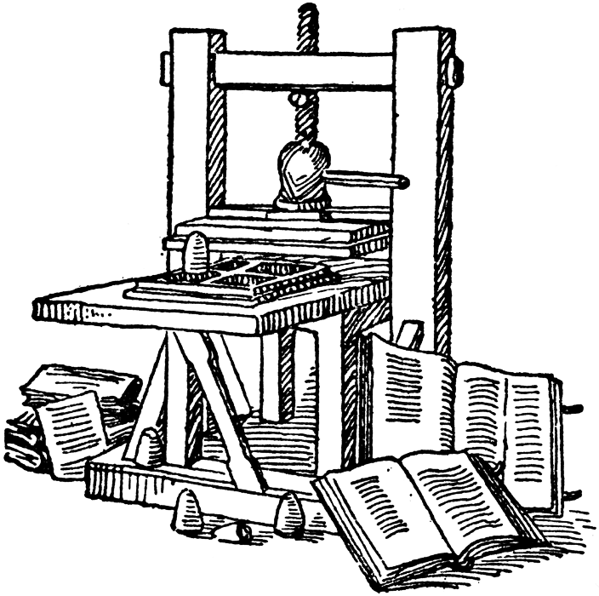
History of Media [McLuhan]
McLuhan proposed that media shapes society and culture—he defines media as “ways of communicating that are extensions of a human being’s senses” [McLuhan 1955]
Tribal era
Literary era
Print era
Electronic era (“The Global Village”)
Notes:
He describes a history of media starting with the tribal era,
where speech shared in a group was a unifying act leading
to enthusiasm and spontaneity. This gave way to the literary
era with the development of writing, which could be
referred to multiple times and reflected on independently.
The literary era was succeeded by the print era, where the
Gutenberg printing press facilitated mass reproductions, allowing
people to consume the content in isolation. The introduction
of instant communications brought about by the
telegraph, telephone, radio, TV, information technology and
Internet led to the electronic era. The constant and immediate
contact the electronic era a↵orded across boundaries
led to what McLuhan coined the “global village”.

Slide 9
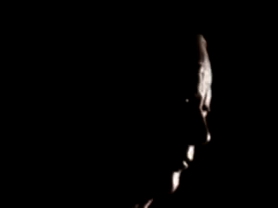
"We shape our tools and thereafter our tools shape us", Laws of Media by Marshall McLuhan
http://www.youtube.com/watch?v=A7GvQdDQv8g
Notes:
But it is best to let Marshall McLuhan tell you himself about his work and insights....
(I’m not sure what he would have thought about YouTube by the way!)
Don't read

Slide 10
McLuhan Quotes:
The medium is the message. 1958
It is the framework which changes with each new technology and not just the picture within the frame. 1955
There are many reasons why most people prefer to live in the age just behind them. It's safer. To live right on the shooting line, right on the frontier of change, is terrifying. 1970
Notes:
I put these quotes on the slide because the audio is quite bad on the youtube video (the original clips are rather old).
"The medium is the message. This is merely to say that the personal and social consequences of any medium - that is, of any extension of ourselves - result from the new scale that is introduced into our affairs by each extension of ourselves, or by any new technology." It isn’t just the content that matters, but rather how it is delivered.
http://wiki.csisdmz.ul.ie/wiki/Marshall_McLuhan_-_The_Medium_is_the_Message
In terms of frame quote mention early studies of TV showed no real difference from print media because they used methods that applied to investigating text, but different questions and methods for studying TV were needed...
We are living right now I believe on this frontier of change, and although it is exhilarating it is also terrifying!

Slide 11
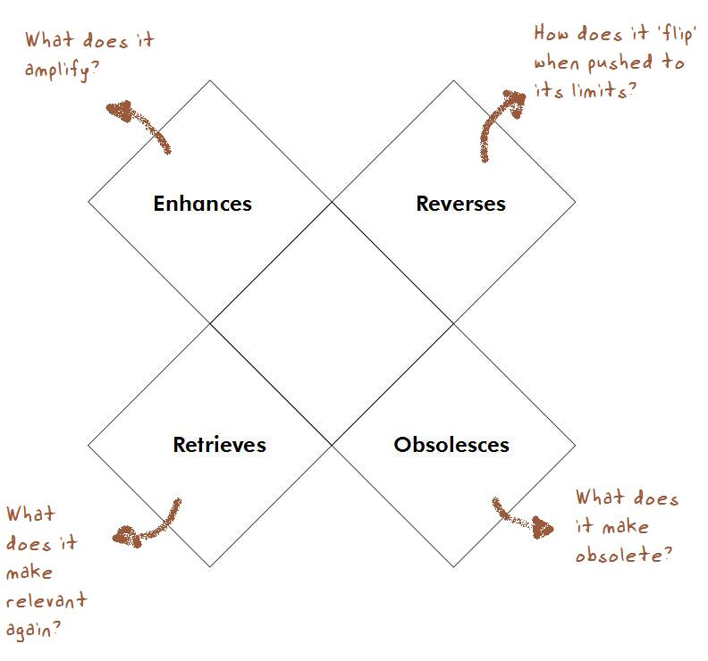
Medium
Notes:
In addition to some thought provoking quotes, McLuhan also gave us a tetrad as a way of thinking about media. Specially it poses a set of four high level questions we should pose when trying to understand the impact of media in a new domain or community of practice, or understand a new form of media.
Examples:
Car enhances: speed; cell phone enhances use of voice.
Car reverses into gridlock traffic; cell phone reverses into being a leash.
Car retrieves the notion of knights in armour; cell phone retrieves the use of cameras.
Car makes obsolete horse and buggy ; cell phone makes obsolete telephone booth.
Taken from:
http://www.collectionscanada.gc.ca/innis-mcluhan/030003-2000-e.html

Slide 12
Social Media and
Participatory Cultures [Jenkins]
Social media bring about a participatory culture with the following attributes:
Low barriers to artistic expression and engagement
Strong support for creating and sharing one’s creations
Informal mentorship—what is known by the experienced is passed along to novices
Members believe their contributions matter
Members feel some degree of social connection and care what others think about their creations

Slide 13
Participatory cultures call for a new form of social literacy [Jenkins]
Notes:
This new participatory culture calls for a new form of literacy,
social media literacy skills that are ways of interacting
with a larger community of practice in contrast to individual
skills used for personal expression through mass media.

Slide 14
Should McLuhan have referred to this more recent era as the “Social Era”?
Notes:
Tribal era
Literary era
Print era
Electronic era (“The Global Village”)

Slide 15
Outline
Theories of media
Social media technologies
Characteristics of social media
Social media channels and their affordances
Opportunities and challenges

Slide 16
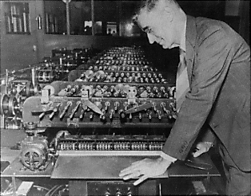
Vannevar Bush: “As we may think” (1945)
  Identified the information storage and retrieval problem!
  “publication has been extended far beyond our present ability to make real use of the record”
Notes:
I know you don’t want a lot of history ☺ But some things are just worth knowing!
article in Atlantic Monthly
Need to reword first paragraph
(need to find my old hci slides!!!!)

Slide 17
The Dawn of the Internet
Arpanet developing in the 1950’s…
First emails were sent in the 1970’s
Usenet newsgroups appeared in 1980’s: “worldwide distributed internet discussion system”
Instant messaging appeared by the end of the 1980’s (IRC, ICQ…)
Notes:
Standage: The Internet brought back social media!
Usenet soon supported the flow
of knowledge about technologies and projects across team,
project, and community members. Users could read and
“post” threaded messages, and posts were referred to as
“news” belonging to specific categories or “newsgroups”. It
was a precursor to forums that are more widely used in
recent years.
Usenet di↵ered from other bulletin boards
at the time as it did not rely on a central server and a dedicated
administrator: it was distributed among a network
of servers that stored and forwarded messages to one another
using “news feeds”. But in other ways, it resembled
the asynchronous text-based discussions on bulletin boards.

Slide 18
Introduction of the WWW
Tim Berners Lee invented the web in 1989 (proposal)
He designed the web as a place where people could interact: “a collaborative medium, a place where we all meet and read and write”
Mosaic browser in 1993

Slide 19
Emergence of the Social Web
At first, authoring required HTML, access to a server and technical knowledge
Chat rooms and discussion rooms existed before the web, but overall, the web was a place of static web pages that users read
Blogging started in 1997 (Blogger in 1999) – no need to know HTML and people could interact (comment, follow others → creating a social network)
Notes:
Blogger now owned by Google

Slide 20
Social media and networking sites
Six Degrees – 1997, people created profiles and listed their friends (grew to one million members)
Friendster launched in 2002, followed by LinkedIn and MySpace (most well known) in 2003
Facebook launched in 2004 (10 years ago!)
2004: Flickr (photo sharing), Digg (social bookmarking site); 2005: Youtube (videos); 2006: Twitter (microblogging)

Slide 21
What’s happened here?
User generated content more common than any type of content by 2007 (“You” as Time Life person of the year in 2007)
The machine is us/ing us: http://www.youtube.com/watch?v=6gmP4nk0EOE
Social media sites dominate top ten websites per year (see http://www.alexa.com/topsites )

Slide 22
Social Networking Features?
Authoring and sharing content (text, photos, videos, etc.)
Following users (may not be reciprocal)
Commenting
Liking
Voting
Tagging links

Slide 23
Outline
Theories of media
Social media technologies
Characteristics of social media
Social media channels and their affordances
Opportunities and challenges

Slide 24
Web as a platform
Architecture of participation
Software as a service
Rich user experience
What is Web 2.0?
Lightweight programming models
Users as co-developers
Control over unique databases
Harnessing
collective intelligence
Social media
Community and social networks
Notes:
Here is my summary from your reading…
Really two sides to Web 2.0….
There are technical innovations as well as a shift in technology development …
Principles more on right hand side
End of the software release cycle
Services and data improve over time….

Slide 25
Social media is…
causing a paradigm shift in software engineering…
  In how we collaboratively author software
  In who is authoring software
  In what kinds of software we develop
Notes:
We will discuss this later….
What I would like to propose is…
Things really didn’t change very much for years – changes were more incremental based on more advanced IDE and languages – but changes were slower
Note – I do agree that this paradigm shift is not occurring everywhere in the software world… but it may in time…

Slide 26
Outline
Theories of media
Social media technologies
Characteristics of social media
Social media channels and their affordances
Opportunities and challenges

Slide 27
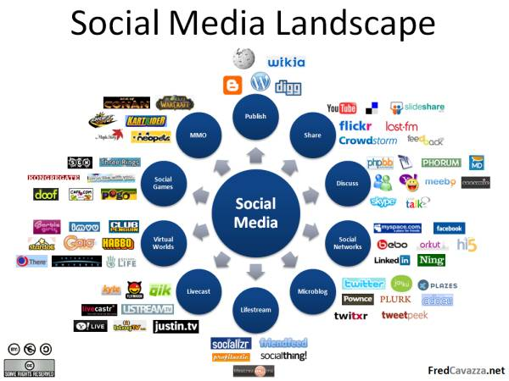

Slide 28
Understanding social media task affordances [Jenkins]
Affiliations: Memberships, formal and informal, in online communities centered around media, such as Friendster, Facebook, MySpace, message boards, or game clans
Expressions: Producing new creative forms, such as digital sampling, fan videos, fan fiction, zines, or mash-ups
Collaborative problem solving: Working in teams, formal and informal, to complete tasks and develop new knowledge, such as Wikipedia, alternative reality gaming
Circulations: Shaping the flow of media, such as podcasting or blogging or microblogging

Slide 29
Outline
Theories of media
Social media technologies
Characteristics of social media
Social media channels and their affordances
Opportunities and challenges

Slide 30
Social production [Yochai Benkler]
For 150 years during the industrial revolution, high costs to access broadcast media
Radical change due to small low cost distributed small contributions at scale – now in the hands of the population at large, money not the motivator!
Not just turning levers, but adding wisdom, creativity that can’t be captured in a manual
Software case is the most visible, because it was measurable
Critical innovation of Google? Outsourcing to determine what is relevant
Notes:
Also looks at historical perspectives -- makes many of the same points as Standage (except he is more of an intellectual so his messages are not as accessible to the masses).
Started with the seti at home example versus super computers -- also gave the open directory versus the yahoo example, and apache versus microsoft example.
5 mins instead of watching TV – breaking tasks down into tiny pieces

Slide 31
Millennial Generation
Used to and expect collaboration
Adept at using social media for communication/coordination/learning
Open, transparent, willing, expect to share
Tightly coupled to their devices and content
How will the world change? How will tools change?
Notes:
e.g. snapchat Morgan’s comment about how it doesn’t fit with web 2.0 characeristics!

Slide 32
Challenges?
Information fragmentation, channel confusion
Keeping up! (new tool opportunities?)
Maintaining a state of flow?
Vendor lock-in
When does social become anti-social?
Trust
Literacy skills

Slide 33
Social media literacy skills [Jenkins]
Play: The capacity to experiment with the surroundings as a form of problem solving
Performance: The ability to adopt alternative identities for the purpose of improvisation and discovery
Simulation: The ability to interpret and construct dynamic models of real-world processes
Appropriation: The ability to meaningfully sample and remix media content
Multitasking: The ability to scan the environment and shift focus onto salient details
Distributed cognition: The ability to interact meaningfully with tools that expand mental capacities

Slide 34
Social media literacy skills cont.
Collective intelligence: The ability to pool knowledge and compare notes with others toward a common goal
Judgment: The ability to evaluate the reliability and credibility of different information sources
Transmedia navigation: The ability to follow the flow of stories and information across multiple modalities
Networking: The ability to search for, synthesize, and disseminate information
Negotiation: The ability to travel across diverse communities, discerning and respecting multiple perspectives, and grasping and following alternative norms

Slide 35

Gamification and marginalization?
Less than 13% of Wikipedia content is authored by women, fewer than 9% of editors are women
Why does this matter?
  Less female oriented content
  Fewer opportunities to gain
  expertise, build portfolios, reputation
“Define Gender Gap? Look up Wikipedia’s Contributor List. New York Times, January, 2011. _x000b_http://www.nytimes.com/2011/01/31/business/media/31link.html
http://blog.20sb.net/2011/10/changing-the-ratio-on-wikipedia.html
Notes:
This is something we need to pay attention to as we are seeing a trend towards programmers gaining experience in open source communities as well as building their portoflios and reputations through these social mechanisms.
http://blog.20sb.net/2011/10/changing-the-ratio-on-wikipedia.html
check numbers.
http://blog.wikimedia.org/c/community/gender-gap-community/
http://www.nytimes.com/2011/01/31/business/media/31link.html

Slide 36
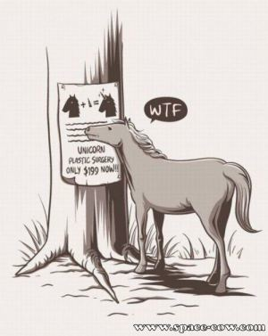
Discussion…
Revolution or evolution?
Notes:
Is it to do with risk and speed?
In terms of risk, this means you don’t know what is going to happen, and perhaps when each of us goes on Facebook we take a risk?

